Slide 1
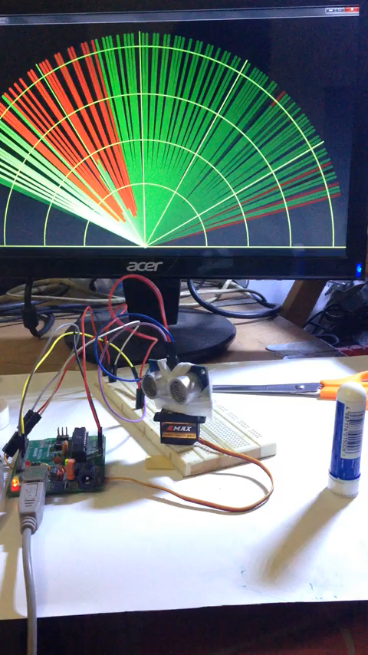
Ultrasonic Radar with Arduino
Detecting Objects Using an Ultrasonic Sensor and Arduino
GOVINDHR-Roll No.[AM.SC.U4CSE23033]
ABHIJITH S- Roll No. [AM.SC.U4CSE23003] DARIPINENI MANOGNA-Roll No.[AM.SC.U4CSE23022]
KRISHNAPRIYA P-Roll No. [AM.SC.U4CSE23044]

Slide 2
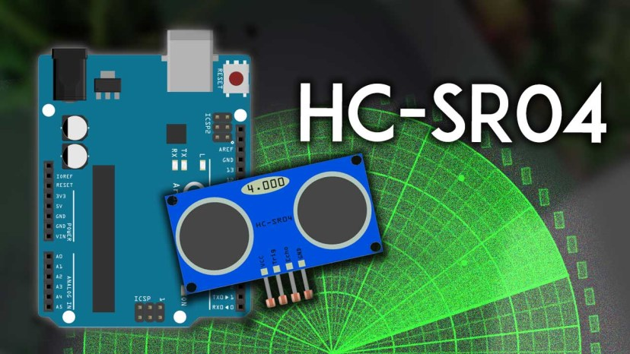
Introduction
What is Ultrasonic Radar?
A system that mimics radar functionality to detect objects and measure their distance.
Purpose of the Project
To create a DIY radar system using Arduino and an ultrasonic sensor for object detection.
Applications
Obstacle detection, robotics, security systems, learning electronics.

Slide 3
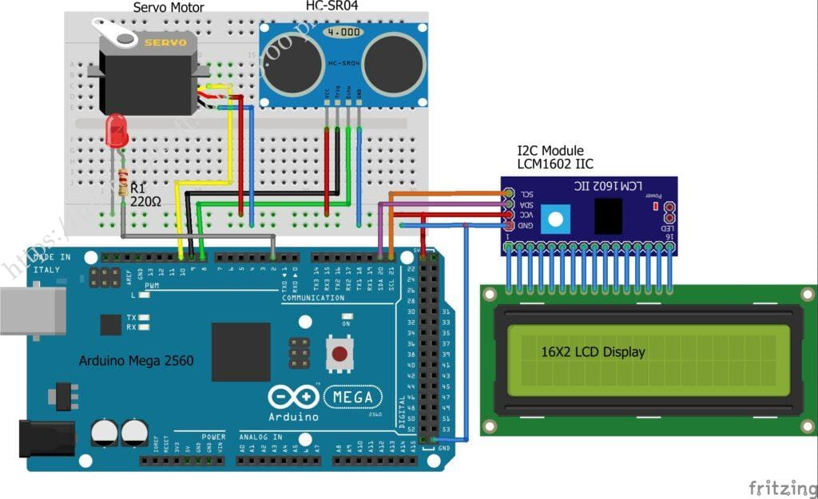
Methodology & Architecture
System Architecture: A diagram showing the connections between components: ultrasonic sensor, servo motor, Arduino, and computer interface.
Key Components: Ultrasonic Sensor (HC-SR04), Servo Motor, Arduino Board, Visualization Interface (e.g., Processing IDE).

Slide 4
Working Principle
Working Principle of Ultrasonic Radar System
Components Involved:
Ultrasonic Sensor (HC-SR04): Emits and receives ultrasonic sound waves.
Servo Motor: Rotates the sensor across a specified angular range.
Arduino Microcontroller: Coordinates the system, processes data, and communicates with the visualization interface.
Ultrasonic Sensor Functionality:
Emits sound waves at 40 kHz from the transmitter.
Waves travel through air, bounce off objects, and return as echoes to the receiver.
Calculates distance using the formula: Distance=Speed of Sound×Time of Flight (ToF)2.\text{Distance} = \frac{\text{Speed of Sound} \times \text{Time of Flight (ToF)}}{2}.Distance=2Speed of Sound×Time of Flight (ToF)​.
Speed of sound in air is approximately 343 m/s.

Slide 5
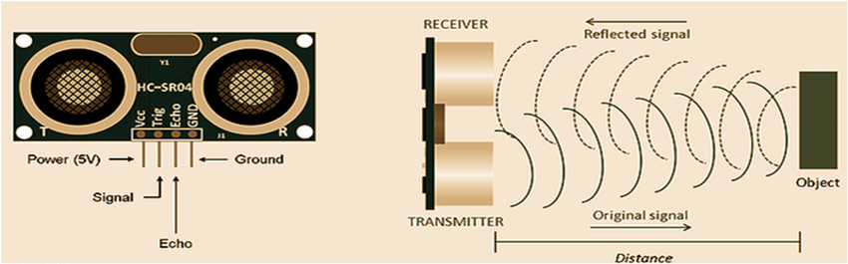
Servo Motor Role:
Rotates the ultrasonic sensor incrementally (e.g., 0° to 180°).
Enables scanning of a wide area by measuring distances at different angles.
Data Processing by Arduino:
Synchronizes the servo motor's movement with the ultrasonic sensor's readings.
Measures Time of Flight (ToF) for sound waves to and from objects.
Calculates and stores distance and angle data.
Visualization on a Computer:
Data (angles and distances) sent to a connected computer via serial communication.
Visualization program (e.g., Processing IDE) interprets data.
Displays objects as "blips" on a radar-like screen, showing their positions relative to the sensor.
Radar-like Output:
Detected objects visualized based on their distance and angle from the sensor.
Mimics radar functionality for object detection and position mapping.

Slide 6
Advantages & Disadvantages
Advantages: Low-cost and DIY-friendly, demonstrates radar principles, useful for educational and small-scale robotics projects.
Disadvantages: Limited range and accuracy compared to actual radars, not suitable for high-speed or high-resolution applications.

Slide 7
Enhanced Features: Use of high-precision sensors for better range and accuracy.
Future Scope
3D Mapping: Adding more degrees of freedom for detailed scanning.
Real-world Applications: Autonomous vehicles, home automation, and robotics.
Integration with wireless communication (Bluetooth/Wi-Fi).

Slide 8
The Ultrasonic Radar with Arduino project effectively demonstrates the principles of radar technology using accessible, low-cost components. By combining an ultrasonic sensor, a servo motor, and an Arduino microcontroller, the system showcases how sound waves can be used to detect and visualize objects in a given area.
This project not only provides a practical introduction to electronics and programming but also fosters an understanding of core concepts such as distance measurement, sensor integration, and data visualization. Its simplicity and adaptability make it an excellent foundation for further exploration in robotics, automation, and IoT applications.
Key Takeaway: The project highlights the potential for creating scalable, cost-effective solutions for real-world problems while serving as an engaging educational tool to inspire innovation and learning in STEM fields.
Conclusion

Slide 9
Arduino Documentation: https://www.arduino.cc
HC-SR04 Sensor Datasheet
References
Processing IDE Tutorials: https://processing.org
DIY Electronics Blogs and Tutorials

Slide 10

Additional Resources
Explore more about ultrasonic sensors and their applications in various fields.
Join online communities and forums for DIY electronics enthusiasts.

Slide 11
Thank you

